Slide 1
Vector Space Model

Slide 2
Today’s lecture
How to represent a document?
Make it computable
How to infer the relationship among documents or identify the structure within a document?
Knowledge discovery

Slide 3
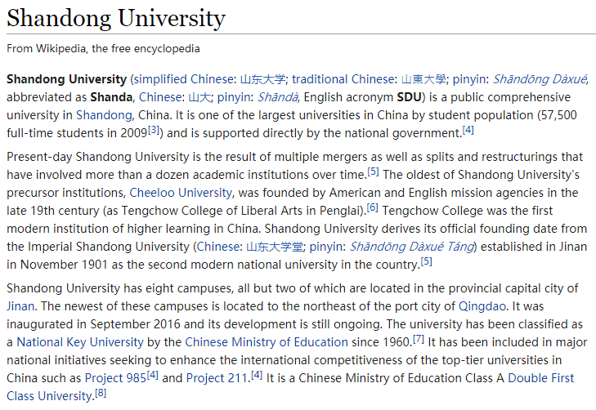
How to represent a document

Slide 4
How to represent a document
Represent by a string?
No semantic meaning
Represent by a list of sentences?
Sentence is just like a short document (recursive definition)

Slide 5
Vector space model
Represent documents by concept vectors
Each concept defines one dimension
k concepts define a high-dimensional space
Element of vector corresponds to concept weight
E.g., d=(x₁,…,x_{k}), x_{i} is the “importance” of concept i in d
Distance between the vectors in this concept space
Relationship among documents

Slide 6
An illustration of VS model
All documents are projected into this concept space
Finance
|D₂-D₄|
D₂
D₄
D₃
Sports
D₅
D₁
Education

Slide 7
What the VS model doesn’t say
How to define/select the “basic concept”
Concepts are assumed to be orthogonal
How to assign weights
Weights indicate how well the concept characterizes the document
How to define the distance metric
Notes:
Orthogonal 英 [ɔ:'θɒgənl] 美 [ɔ:'θɒgənəl] adj.[数]直角的;矩形的;直交的;互相垂直的

Slide 8
What is a good “Basic Concept”?
Orthogonal
Linearly independent basis vectors
“Non-overlapping” in meaning
No ambiguity
Weights can be assigned automatically and accurately
Existing solutions
Terms or N-grams, a.k.a., Bag-of-Words
Topics
We may come back to this later

Slide 9
Bag-of-Words representation
Term as the basis for vector space
Doc1: Text mining is to identify useful information.
Doc2: Useful information is mined from text.
Doc3: Apple is delicious.
 | text | information | identify | mining | mined | is | useful | to | from | apple | delicious
Doc1 | 1 | 1 | 1 | 1 | 0 | 1 | 1 | 1 | 0 | 0 | 0
Doc2 | 1 | 1 | 0 | 0 | 1 | 1 | 1 | 0 | 1 | 0 | 0
Doc3 | 0 | 0 | 0 | 0 | 0 | 1 | 0 | 0 | 0 | 1 | 1

Slide 10
Tokenization
Break a stream of text into meaningful units
Tokens: words, phrases, symbols
Definition depends on language, corpus, or even context
Input: It’s not straight-forward to perform so-called “tokenization.”
Output(1): 'It’s', 'not', 'straight-forward', 'to', 'perform', 'so-called', '“tokenization.”'
Output(2): 'It', '’', 's', 'not', 'straight', '-', 'forward, 'to', 'perform', 'so', '-', 'called', ‘“', 'tokenization', '.', '”‘
Notes:
words, phrases, symbols 单词、短语、符号

Slide 11
Tokenization
Solutions
Regular expressions
[\w]+: so-called -> ‘so’, ‘called’
[\S]+: It’s -> ‘It’s’ instead of ‘It’, ‘’s’
Statistical methods
Explore rich features to decide where the boundary of a word is
Apache OpenNLP (http://opennlp.apache.org/)
Stanford NLP Parser (http://nlp.stanford.edu/software/lex-parser.shtml)
Online Demo
Stanford (http://nlp.stanford.edu:8080/parser/index.jsp)
UIUC (http://cogcomp.cs.illinois.edu/curator/demo/index.html)

Slide 12
Bag-of-Words representation
 | text | information | identify | mining | mined | is | useful | to | from | apple | delicious
Doc1 | 1 | 1 | 1 | 1 | 0 | 1 | 1 | 1 | 0 | 0 | 0
Doc2 | 1 | 1 | 0 | 0 | 1 | 1 | 1 | 0 | 1 | 0 | 0
Doc3 | 0 | 0 | 0 | 0 | 0 | 1 | 0 | 0 | 0 | 1 | 1
Assumption
Words are independent from each other
Pros
Simple
Cons
Basis vectors are clearly not linearly independent!
Grammar and order are missing
The most frequently used document representation

Slide 13
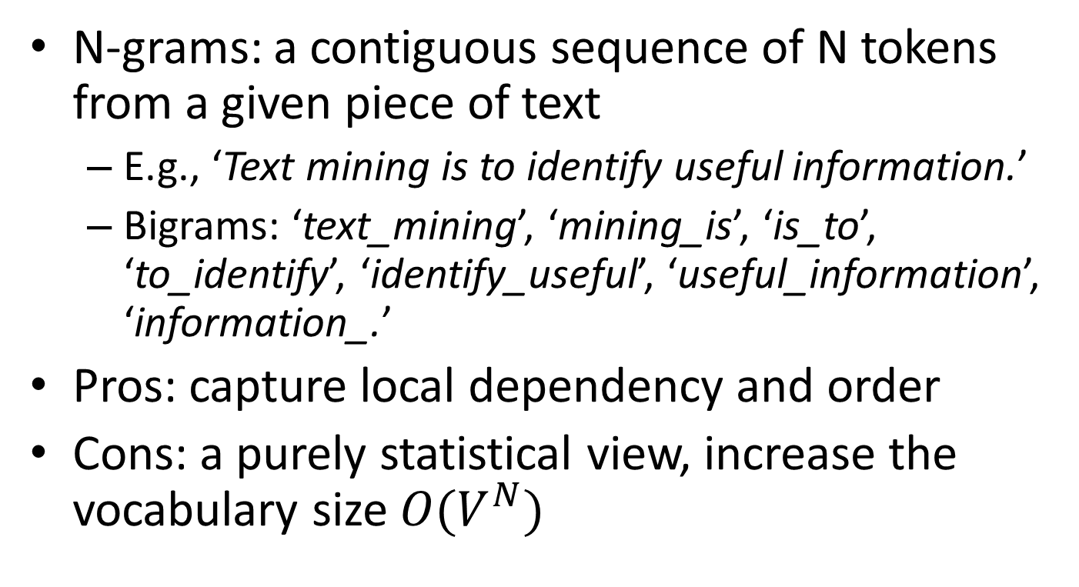
Bag-of-Words with N-grams
N-grams: a contiguous sequence of N tokens from a given piece of text
E.g., ‘Text mining is to identify useful information.’
Bigrams: ‘text_mining’, ‘mining_is’, ‘is_to’, ‘to_identify’, ‘identify_useful’, ‘useful_information’, ‘information_.’
Pros: capture local dependency and order
Cons: a purely statistical view, increase the vocabulary size $O(V^{N})$

Slide 14
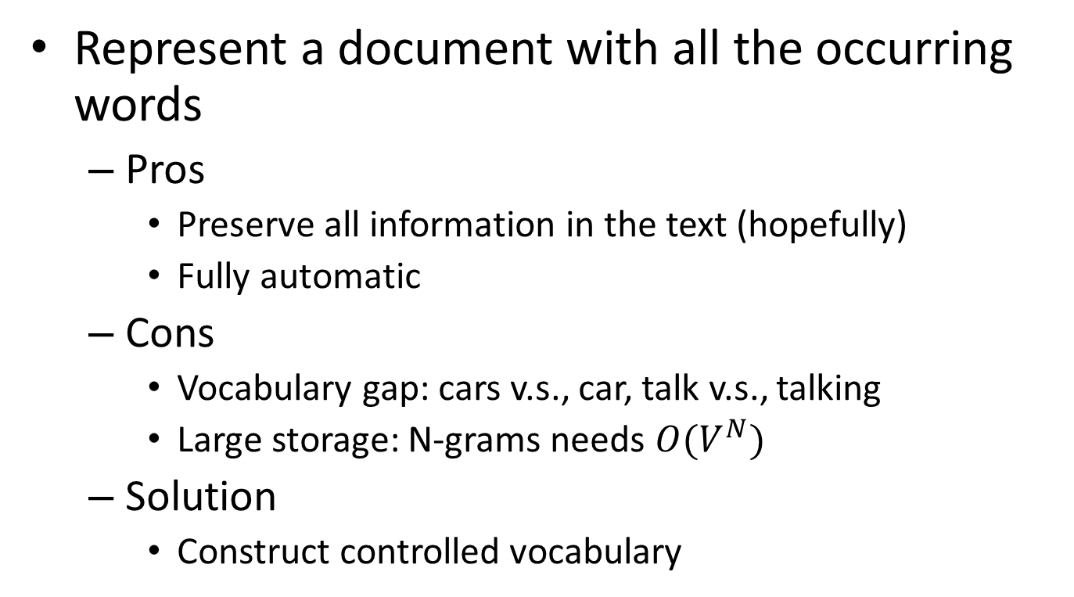
Automatic document representation
Represent a document with all the occurring words
Pros
Preserve all information in the text (hopefully)
Fully automatic
Cons
Vocabulary gap: cars v.s., car, talk v.s., talking
Large storage: N-grams needs $O(V^{N})$
Solution
Construct controlled vocabulary

Slide 15
A statistical property of language
Zipf’s law
Frequency of any word is inversely proportional to its rank in the frequency table

Slide 16
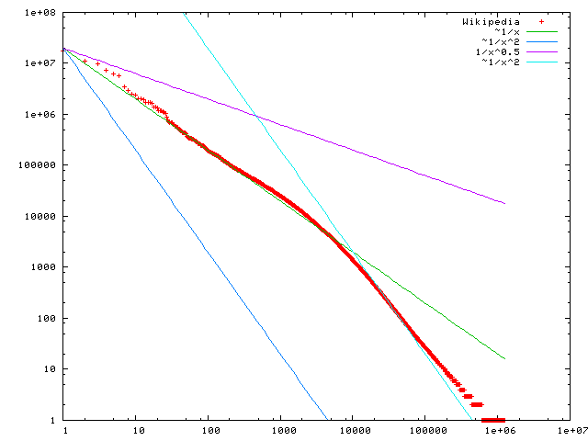
A statistical property of language
Zipf’s law
Frequency of any word is inversely proportional to its rank in the frequency table
Word frequency
Word rank by frequency
A plot of word frequency in Wikipedia (Nov 27, 2006)

Slide 17
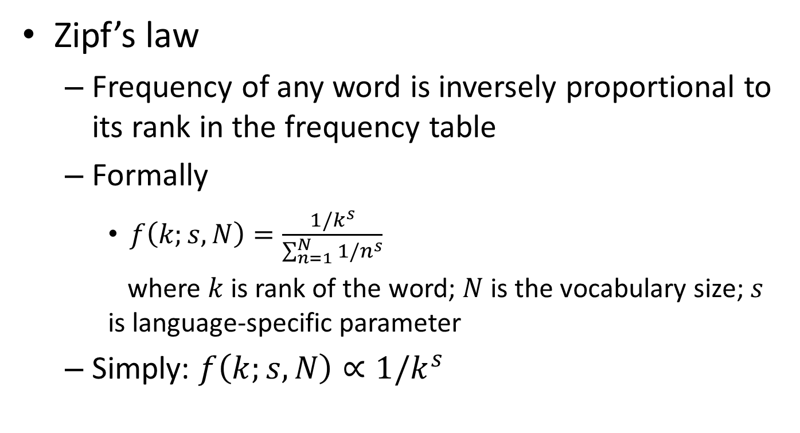
A statistical property of language
Zipf’s law
Frequency of any word is inversely proportional to its rank in the frequency table
Formally
$f\left(k;s,N\right)=\frac{1/k^{s}}{\sum_{n=1}^{N}{1/n^{s}}}$
where $k$ is rank of the word; $N$ is the vocabulary size; $s$ is language-specific parameter
Simply: $f\left(k;s,N\right)∝1/k^{s}$

Slide 18
A statistical property of language
Zipf’s law
Frequency of any word is inversely proportional to its rank in the frequency table
Formally
$f\left(k;s,N\right)=\frac{1/k^{s}}{\sum_{n=1}^{N}{1/n^{s}}}$
where $k$ is rank of the word; $N$ is the vocabulary size; $s$ is language-specific parameter
Simply: $f\left(k;s,N\right)∝1/k^{s}$
Discrete version of power law
Word frequency
In the Brown Corpus of American English text, the word "the" is the most frequently occurring word, and by itself accounts for nearly 7% of all word occurrences; the second-place word "of" accounts for slightly over 3.5% of words.
Word rank by frequency
A plot of word frequency in Wikipedia (Nov 27, 2006)

Slide 19
Zipf’s law tells us
Head words take large portion of occurrences, but they are semantically meaningless
E.g., the, a, an, we, do, to
Tail words take major portion of vocabulary, but they rarely occur in documents
E.g., dextrosinistral （从右至左的）
The rest is most representative
To be included in the controlled vocabulary

Slide 20
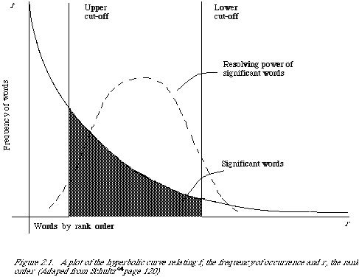
Automatic document representation
Remove non-informative words
Remove rare words

Slide 21
Normalization
Convert different forms of a word to a normalized form in the vocabulary
U.S.A. -> USA, St. Louis -> Saint Louis
Solution
Rule-based
Delete periods（句号） and hyphens（连字符）
All in lower cases
Dictionary-based
Construct equivalent class
Car -> “automobile, vehicle”
Mobile phone -> “cellphone”
Notes:
period英 [ˈpɪəriəd] 美 [ˈpɪriəd] n.时期;（一段）时间;学时;句号
Hyphens 连字符，连号

Slide 22
Stemming
Reduce inflected or derived words to their root form
Plurals(复数), adverbs(副词), inflected word forms
E.g., ladies -> lady, referring -> refer, forgotten -> forget
Solutions (for English)
Porter stemmer: patterns of vowel-consonant sequence
Krovetz stemmer: morphological rules
Risk: lose precise meaning of the word

Slide 23
Stopwords
Useless words for document analysis
Not all words are informative
Remove such words to reduce vocabulary size
No universal definition
Risk: break the original meaning and structure of text
E.g., this is not a good option -> option
to be or not to be -> null

Slide 24
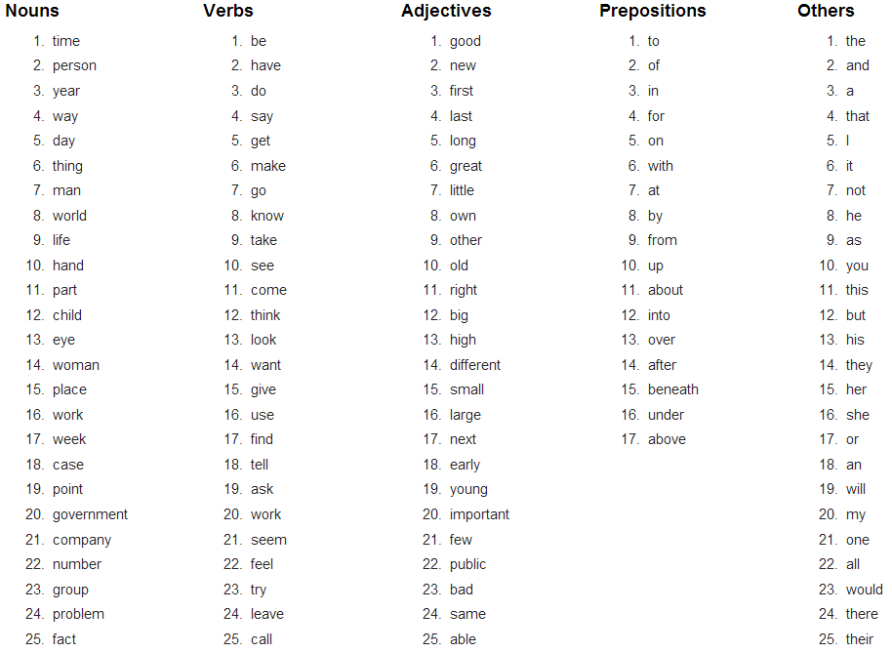
Stopwords
The OEC: Facts about the language

Slide 25
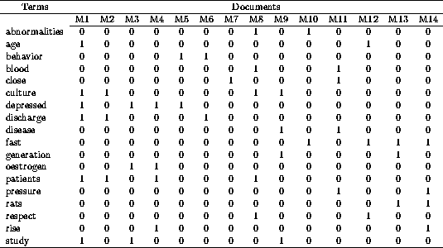
Constructing a VSM representation
D1: ‘Text mining is to identify useful information.’
Tokenization:
D1: ‘Text’, ‘mining’, ‘is’, ‘to’, ‘identify’, ‘useful’, ‘information’, ‘.’
Stemming/normalization:
D1: ‘text’, ‘mine’, ‘is’, ‘to’, ‘identify’, ‘use’, ‘inform’, ‘.’
N-gram construction:
D1: ‘text-mine’, ‘mine-is’, ‘is-to’, ‘to-identify’, ‘identify-use’, ‘use-inform’, ‘inform-.’
Stopword/controlled vocabulary filtering:
D1: ‘text-mine’, ‘to-identify’, ‘identify-use’, ‘use-inform’
Documents in a vector space!

Slide 26
How to assign weights?
Important!
Why?
Corpus-wise: some terms carry more information about the document content
Document-wise: not all terms are equally important
How?
Two basic heuristics
TF (Term Frequency) = Within-doc-frequency
IDF (Inverse Document Frequency)

Slide 27
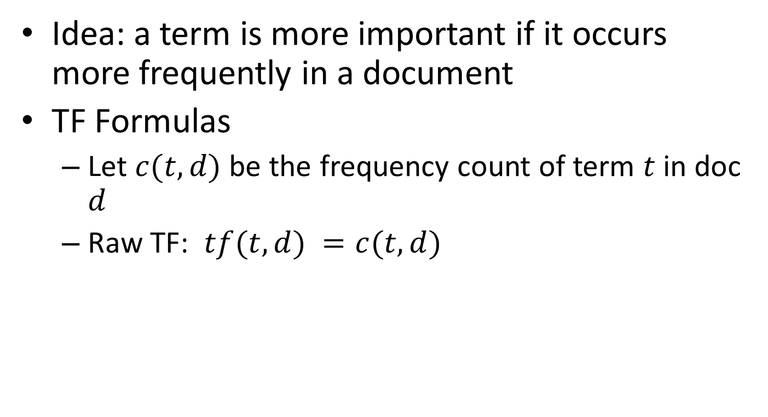
Term frequency
Idea: a term is more important if it occurs more frequently in a document
TF Formulas
Let $c(t,d)$ be the frequency count of term $t$ in doc $d$
Raw TF: $tf(t,d) =c(t,d)$

Slide 28
TF normalization
Two views of document length
A doc is long because it is verbose (冗长的)
A doc is long because it has more content
Raw TF is inaccurate
Document length variation
“Repeated occurrences” are less informative than the “first occurrence”
Information about semantic does not increase proportionally with number of term occurrence
Generally penalize long document, but avoid over-penalizing
Length normalization

Slide 29

TF normalization
Sub-linear TF scaling
$tf\left(t,d\right)=\left\{\begin{aligned}1+\log{c\left(t,d\right)}, if c\left(t,d\right)>0 \\ 0, otherwise\end{aligned}\right.$
Norm. TF
Raw TF

Slide 30


TF normalization
Maximum TF scaling
$tf\left(t,d\right)=α+(1−α)\frac{c(t,d)}{\max_{t}{c(t,d)}}$
Normalize by the most frequent word in this doc
Norm. TF
1
$$α$$
Raw TF

Slide 31
Document frequency
Idea: a term is more discriminative（有判别力的） if it occurs only in fewer documents

Slide 32

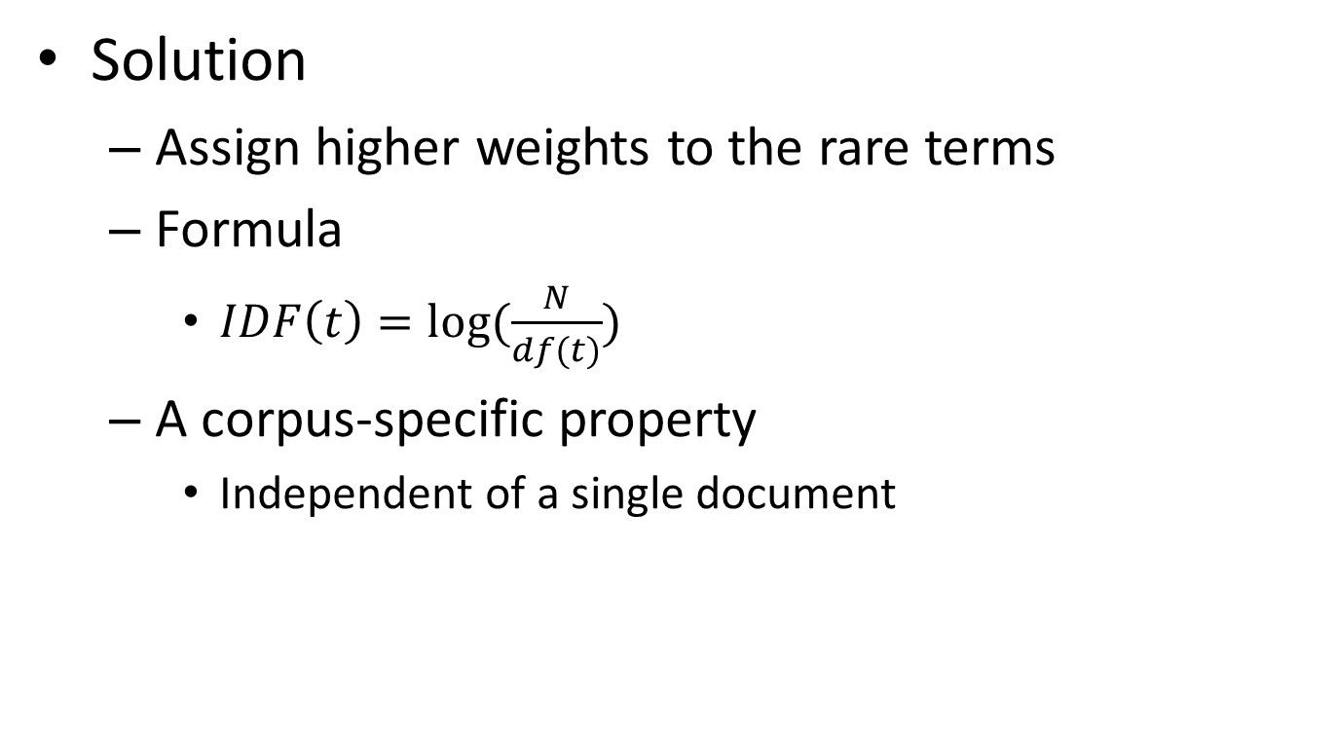
Inverse document frequency
Solution
Assign higher weights to the rare terms
Formula
$IDF\left(t\right)=log⁡(\frac{N}{df(t)})$
A corpus-specific property
Independent of a single document
Non-linear scaling
Total number of docs in collection
Number of docs containing term $t$

Slide 33
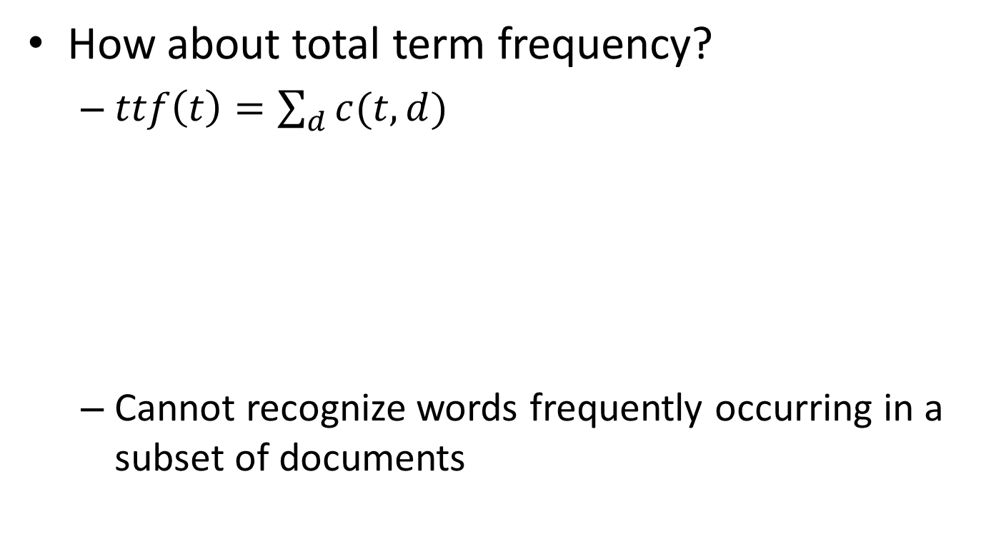
Why document frequency
How about total term frequency?
$ttf\left(t\right)=\sum_{d}{c(t,d)}$
Cannot recognize words frequently occurring in a subset of documents
Table 1. Example total term frequency v.s. document frequency in Reuters-RCV1 collection.
Word | ttf | df
try | 10422 | 8760
insurance | 10440 | 3997

Slide 34
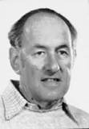
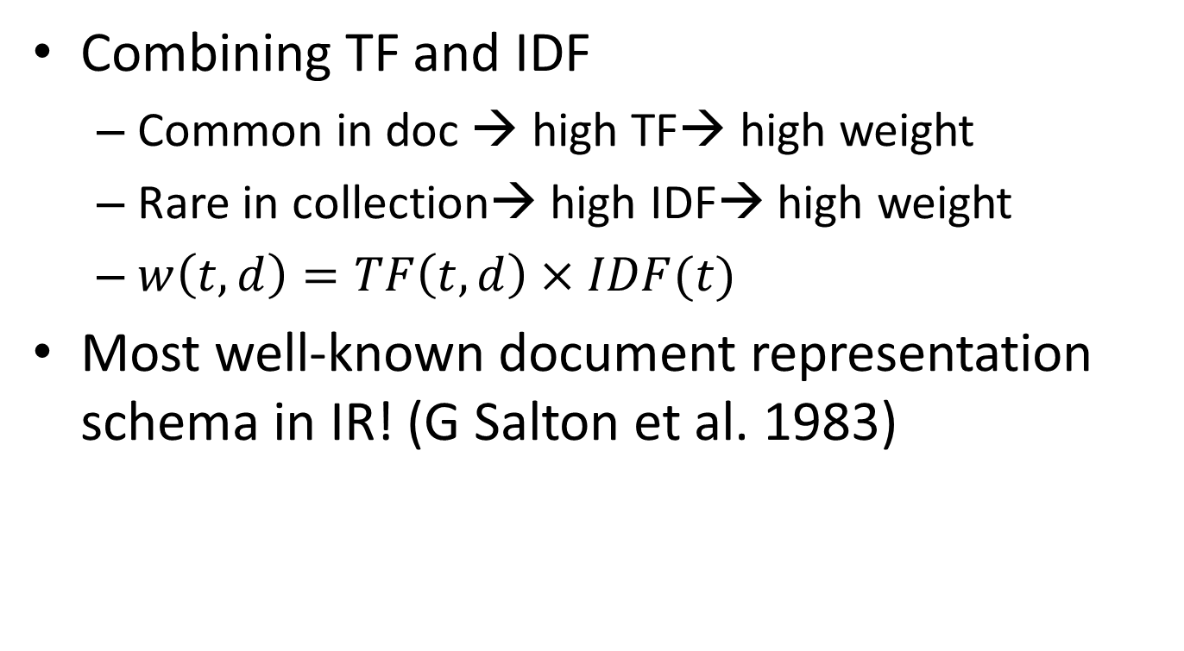
TF-IDF weighting
Combining TF and IDF
Common in doc → high TF→ high weight
Rare in collection→ high IDF→ high weight
$w\left(t,d\right)=TF\left(t,d\right)×IDF(t)$
Most well-known document representation schema in IR! (G Salton et al. 1983)
“Salton was perhaps the leading computer scientist working in the field of information retrieval during his time.” - wikipedia
Gerard Salton Award
– highest achievement award in IR

Slide 35
How to define a good similarity metric?
Euclidean distance?
Finance
TF-IDF space
D₂
D₄
D₃
Sports
D₆
D₅
D₁
Education

Slide 36
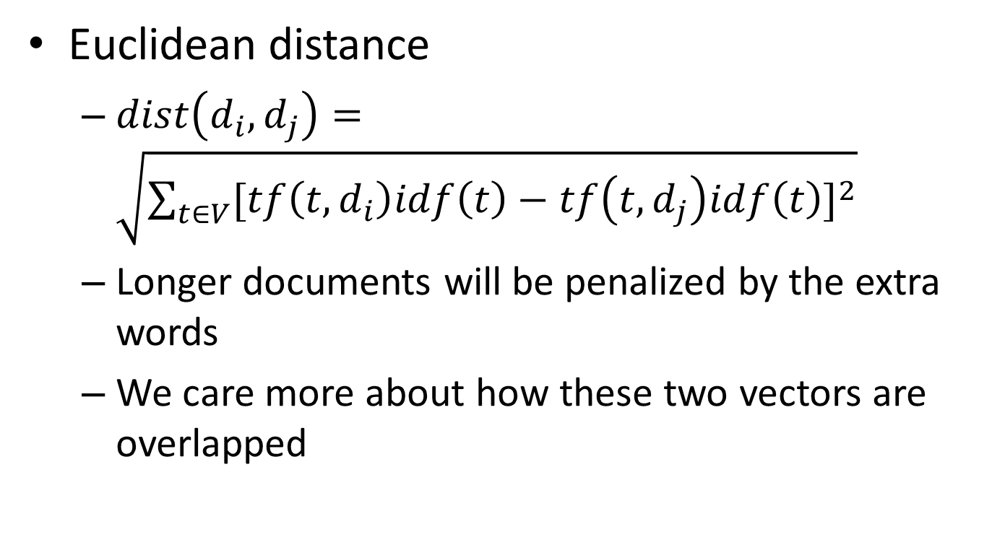
How to define a good similarity metric?
Euclidean distance
$dist\left(d_{i},d_{j}\right)=\sqrt{\sum_{t∈V}{{[tf\left(t,d_{i}\right)idf\left(t\right)−tf\left(t,d_{j}\right)idf\left(t\right)]}^{2}}}$
Longer documents will be penalized by the extra words
We care more about how these two vectors are overlapped

Slide 37
From distance to angle
Angle: how vectors are overlapped
Cosine similarity – projection of one vector onto another
Finance
TF-IDF space
D₁
The choice of angle
The choice of Euclidean distance
D₂
D₆
Sports

Slide 38

Cosine similarity
TF-IDF vector
Angle between two vectors
$cosine\left(d_{i},d_{j}\right)=\frac{V_{d_{i}}^{T}V_{d_{j}}}{{\left|V_{d_{i}}\right|}_{2}×{\left|V_{d_{j}}\right|}_{2}}$
Documents are normalized by length
Unit vector
Finance
D₂
TF-IDF space
D₁
D₆
Sports

Slide 39
Advantages of VS model
Empirically effective(有效的)!
Intuitive (直观的)
Easy to implement
Well-studied/mostly evaluated
The Smart system
Developed at Cornell: 1960-1999
Still widely used
Warning: many variants of TF-IDF!

Slide 40
Disadvantages of VS model
Assume term independence
Lots of parameter tuning!

Slide 41
What you should know
Basic ideas of vector space model
Procedures of constructing VS representation for a document
Two important heuristics in bag-of-words representation
TF
IDF
Similarity metric for VS model

Slide 42
Today’s reading
Introduction to information retrieval
Chapter 2.2: Determining the vocabulary of terms
Chapter 6.2: Term frequency and weighting
Chapter 6.3: The vector space model for scoring
Chapter 6.4: Variant tf-idf functions

Slide 43
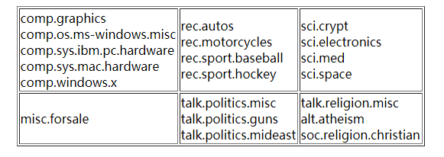
Homework 1: VSM
Deadline: 2018.9.26, 23:00
预处理文本数据集，并且得到每个文本的VSM表示。
The 20 Newsgroups dataset is a collection of approximately 20,000 newsgroup documents, partitioned (nearly) evenly across 20 different newsgroups.
20news-18828.tar.gz - 20 Newsgroups; duplicates removed, only "From" and "Subject" headers (18828 documents)
http://qwone.com/~jason/20Newsgroups/

Slide 44
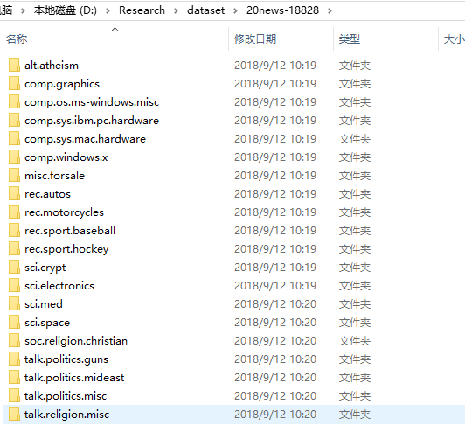
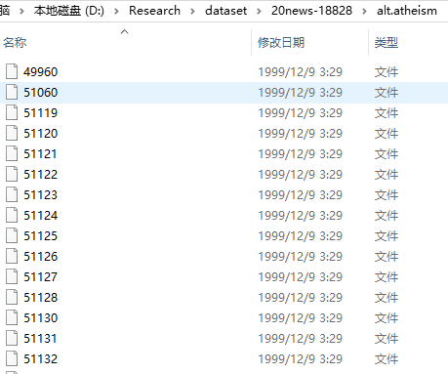
Homework 1: VSM
Deadline: 2018.9.26, 23:00
http://qwone.com/~jason/20Newsgroups/

Slide 45

Homework 1: VSM
Deadline: 2018.9.26, 23:00
https://github.com/

Slide 46
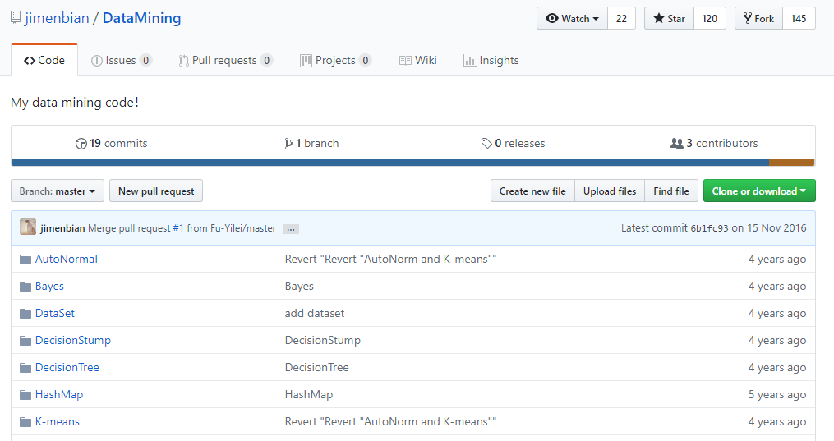
Homework 1: VSM
Deadline: 2018.9.26, 23:00
项目命名：学号+姓名拼音
https://github.com/jimenbian/DataMining/

